Slide 1
Curriculum Development
All materials from today’s workshop will found at:
www.ellseelearning.weebly.com
MUST & ELTAM December 2013
Ninj Erdene ELTAM
Laura Connor English Language Fellow MUST
Bulgan Sandagdorj MUST English Teacher

Slide 2
Today’s Agenda
INTRODUCTION TO WORKSHOP
Session One: Importance of Standards & Objectives
Session Two: Lesson Planning & Student Centered Learning
LUNCH BREAK 12:30-1:10
Session Three: Assessment
TEA BREAK
Session Four:
Curriculum Development : Putting It All Together

Slide 3
Today’s Objectives
By the end of today’s workshop, participants will be able to…
Understand & create meaningful objectives to drive their planning & instruction.
Create a lesson plan that is structured to enhance task-based student centered learning and in turn, critical thinking.
How to incorporate text books, workbooks, and supplemental materials into a lesson plan and curriculum.
Identify 4 types of assessment that best assess objectives learned by students.
Understand the structure of a curriculum and how to develop their own unit to enhance the language learning of their students to be more purposeful and create more measurable outcomes.

Slide 4
KWL Warm Up: Curriculum Development
What Do You Know About Curriculum Development? | What Do You Want to Know About Curriculum Development? | What Have You Learned About Curriculum Development?
Example: I know curriculum is all of the lessons of a class outlined. 2. Main working paper for departments in a university to follow 3. 4. | Example: How can I use it with my workbooks? 2. How to use other books that are new to the semester for our classes and curriculum. 3. How to develop curriculum effectively 4. | 1. 2. 3. 4.

Slide 5
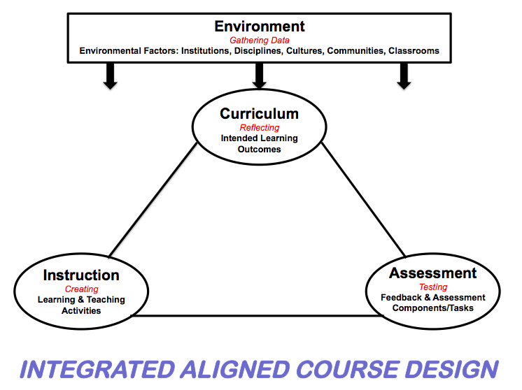

Slide 6
Understanding by Design Grant Wiggins and Jay McTighe
What is backward design?

Slide 7
Why “backward”?
The stages are logical but they go against habits
We’re used to jumping to lesson and activity ideas - before clarifying our performance goals for students
By thinking through the assessments upfront, we ensure greater alignment of our goals and means, and that teaching is focused on desired results
Top down
“Always plan with the end in mind”
Notes:
Why “backward”? Because for most of us, this design model asks us to re-examine our curriculum development practices and to look at them in different light.

Slide 8
Important terminology for today:
Curriculum = a series of units and lessons that help learners achieve specific academic or occupational goals. A curriculum often consists of general learning objectives and a list of courses and resources.
Standard= a rule or principle that is used as a basis for judgment OR an average or normal requirement, quality, quantity, level, grade, etc.:.
Objective = something that one's efforts or actions are intended to attain or accomplish; purpose; goal; target.
Assessment = to judge the value or quality of work

Slide 9
Standards & Objectives
In this part of the workshop, participants will…
Know and understand the 5 C’s EFL Standards
Create meaningful objectives using standards to use in their planning & instruction.

Slide 10
Purpose Of Standards
Holds everyone to the same expectation
Gives teachers a framework with which to plan their lessons, units, & curriculums
Ensures that all teachers are teaching the same concepts
Develop & maintain linguistic and cultural proficiency by having a common goal for teachers & students
Connects the learning that occurs throughout classes, and provides measurement for that.
PLANNING WITH THE END (OUTCOMES) IN MIND

Slide 12
Purpose of Objectives
Sets a target for students and teacher to meet by the end of the lessons
Allows students to be accountable for their learning.
Provides a framework for your lesson plan, unit and curriculum.
Gives a focus to the lesson
Does this activity help my students to achieve my objective?
How can I BEST get my students to meet this objective?
Notes:
Highlight that the first thing that the facilitators did for this workshop was outline objectives of what we wanted participants to walk away being able to do, and then designed the workshop’s instruction and activities based on those objectives.

Slide 13
Let’s Try to Match these Objectives with Standards:
SWBAT present a researched place of travel they would like to visit in an oral presentation.
SWBAT use word parts to create meaning of new vocabulary words.
SWBAT work in groups to create a dialogue about a place of travel
(Standard 1.1, 1.3, 2.1)
(Standard 1.2)
(Standard 1.1, 1.2, 1.3, 2.1, 3.1)

Slide 14
Work with a partner(s) to create 1-3 objective(s) based on 1 or more of the five C standards
You may create a new lesson topic or use a topic from a previous lesson.
Remember this objective with drive your lesson plan, so make it something that you feel comfortable teaching and that will engage students.

Slide 15
Session two:
Lesson planning and student centred learning
Presenters: Bulgan Sandagdorj
Laura Connor
Notes:
Putting some examples of my lesson.

Slide 16
Objective of the session:
To create a lesson plan that is structured to enhance task-based student centred learning and critical thinking.

Slide 17
What is a lesson?
Lessons in different places may vary in topic, time, place, atmosphere, methodology and materials, but they all, essentially, are concerned with learning as their main objective, involve the participation of learners and teachers, and are limited and pre-scheduled as regards time, place and membership.
(Harmer, 2006, p. 72)

Slide 18
Lesson planning
Who is this course for?
What is the course about?
What kind of teaching and learning will take place in the course?

Slide 19
Learner differences
Learner
motivation
Learner
interest
Learner
age
Learner
preference

Slide 20
Ordering components of a lesson
Put the mentally challenging tasks earlier
Have quieter activities before lively ones
Think about transitions
Pull the class together at the beginning and the end
End on a positive note

Slide 21
Pattern of classroom interaction
The most common type of classroom interaction is “IRF”- ‘Initiation-Response-Feedback’: the teacher initiates an exchange, usually in the form of a question, one of the students answers, the teacher gives feedback (assessment, correction, comment), initiates the next question- and so on.
(Sinclair and Coulthard, 1975)

Slide 22
Suggested classroom interaction pattern: Brainstorming

Slide 23
Classroom interaction patterns
Group work
Closed-ended teacher questioning
Individual work
Choral responses
Collaboration
Student initiates, teacher answers
Full-class interaction
Teacher talk
Self-access
Open-ended teacher questioning

Slide 24
Codes:
TT= Teacher very active, students only receptive
T= Teacher active, students mainly receptive
TS= Teacher and students fairly equally active
S= Students active, teacher mainly receptive
SS= Students very active , teacher only receptive

Slide 25
Role and design of instructional materials
printed materials (books, workbooks, worksheets)
Non-print materials (cassette, audio materials, videos, computer based materials)
Both print and non-print sources(self-access materials, materials on the internet)
Notes:
Now we have just created our objective of our lesson. Explaining about my lesson plan.

Slide 26
Role and design of instructional materials cont.
Materials serve the following functions:
as a source of language
as a learning support
for motivation and stimulation
for reference
(Dudley-Evans., & St. John, 1998, p. 170-171)

Slide 27
 | AUTHENTIC MATERIALS | CREATED MATERIALS
PROS | More motivating More interesting Provide authentic cultural information Provide exposure to real language Relate more closely to learners’ needs Support more creative approach to teaching | Can also be motivating Specifically built around syllabus Provide systematic coverage of teaching items
CONS | Contain difficult language & unneeded vocabulary items Teacher needs to spend considerable amount of time to adjust syllabus | Can be boring

Slide 28
Short-sequence movie lesson
THE KING'S SPEECH (2010) Short Sequence: The Royal Visit

Slide 29
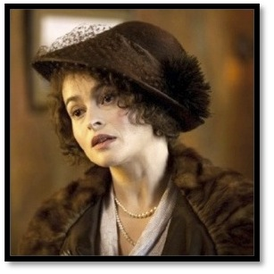
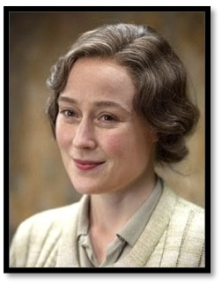
Characters
King George VI (Bertie
Queen Elizabeth
Lionel Logue
Myrtle Logue

Slide 30
A | First Watch. 1:16:45 Main Idea.
1. Why did King George and Queen Elizabeth visit Lionel?
_______________________________________ 2. How did Lionel treat King George?
____________________________________________

Slide 31
B | Vocabulary in Movie Quotations
1. apologize--(v.) say you are sorry 2. one--(pronoun) any person 3. go about (it)--(v.) do your work 4. square one--(n.) the beginning 5. succeed*--(v.) become the new king 6. predecessor--(n.) person who held the job before 7. bloody--(adj.) very bad (British slang) 8. precisely*--(adv.) exactly 9. previous*--(adj.) before 10. engagement--(n.) meeting plan

Slide 32
C | Second Watch. 1:16:45. Detail Questions.
How do the King and Queen feel about Lionel's home?
2. What did Lionel offer to the Queen?
3. What is King George's problem?

Slide 33
C | Second Watch. 1:16:45. Detail Questions.(continue)
4. Who is Lionel Logue?
5. What advice has Lionel given to
King George?
6. Who is Myrtle?

Slide 34
C | Second Watch. 1:16:45. Detail Questions.(continue)
7. Has Lionel told about the King and
himself to his wife?
8. How did Myrtle react to meeting
Queen Elizabeth?
9. What names do Lionel and King
George use for each other?

Slide 35
C | Second Watch. 1:16:45. Detail Questions.(continue)
10. Why does Queen Elizabeth say
"no" to Myrtle's invitation?

Slide 36
Task based learning Literature review
Makes the performance of meaningful tasks central to the learning process (Harmer, 2006)
Tasks have to be completed first
Teacher discuss the language that was used in the tasks and make corrections and adjustments
PPP upside down process (Willis, 1994)

Slide 37
Task–based learning: brainstorm!

Slide 38
Summary Factors in lesson planning
Develop aims and objectives
The context for teaching
Needs of teachers and learners
Careful planning of courses and materials
Monitoring of teaching and learning

Slide 40
STANDARDS
ENVIRONMENT
CURRICULUM
UNIT
Lesson 1
Lesson 3
Lesson 2

Slide 41
Benefits of Small Group Learning
Collaboration
Allows for more communication and interaction in a more relaxed setting
Students are more questions and explanations (critical thinking).
TEAM WORK! Real life problem solving and social interactions
Real use of social language and English for specific purposes.
Can group students by levels and needs.
Allows time to work with lower level students

Slide 42
STUDENT CENTERED LESSON
Teacher gives goals/objectives.
Models learning task- thinks out loud.
Lectures as students listen/note-take
I DO
Students try task in pairs, or with guidance of the teacher.
More modeling if necessary
Teacher checks for understanding
→ Meet with lower level learners
WE DO
Collaborative learning
Students work independently from teacher in small groups or alone
Teacher checks for understanding
→ Meet with lower level learners
YOU DO

Slide 44
Sample lesson plan:
Class: Speaking III Unit: Travel
Objective: SWBAT use and explain travel idioms.
SWBAT work with a partner to present their work to peers.
Agenda:
Warm Up: 4 square model vocabulary word: Globetrotter
Mini Lesson:
2. I DO: Teacher will introduce students to travel idioms. SW take notes in their chart about the meaning of each new idiom. SW ask questions for clarification; TW question throughout.
3. WE DO: SW work in partners to complete matching exercise- match the idiom with the correct definition. TW review answers whole class.
4. YOU DO: SW get a slip of paper with half of an idiom written on it. They have to find the student who has the other half of paper that matches their idiom. Pairs will then work together to draw a picture to represent their travel idiom. SW use that travel in idiom in a sentence.
5. Whole Class: SW share their picture to the whole class. Students will guess which idiom they had. Pairs will then give the sentence they created for the picture.
6. Wrap Up: Students will write 3 sentences. SW use the word globetrotter and 2 travel idioms in their sentences. TW collect their sentences at the end of class.

Slide 45
YOU DO!
Work with your group to plan a lesson using the student centered lesson plan
Be sure to focus all activities on your objective & standard
Be sure to make the class student centered
How will you know that your students have met the day’s objective?

Slide 46
Assessment in
Curriculum Development

Slide 47
ASSESSMENT
In this part of the workshop, participants will be able to…
Identify 4 types of assessment that best assess objectives learned by students.
“Students can hit any target they can see that holds still for them.” ~ Rick Stiggins
Therefore, if students have no idea what they are supposed to learn, few of them will be able to monitor their own progress- or hit that target.
Notes:
Give example: If you are teaching students travel idioms, they should be aware that they are expected to know and understand this by the end of the lesson today. If students are expected to be able to speak in the conditional tense, they should know this. If I need to run 10 kilos by January 1st, I need to know this before I am expected to do so.

Slide 48
4 ASSESSMENT METHODS:
Selected Response: multiple choice, true/false, matching, short answer, and fill in-question.
Extended Written Response: Asks a student to compare, analyze, interpret, solve & explain, and describe in detail. This is useful when connecting several ideas, or asking a student to explain their thinking.
Performance Assessment: an observation & judgment of a performance or product. Examples: group projects, oral presentation, problem solving, poster project, etc. Also includes checklists and rubric.
Personal Communication: information from interacting with students. Examples: questioning, listening to students, oral exams, conferences, journals, etc.
Notes:
After clarifying the urpose and learning targets for your assessment, the net key to creating effective assessments is to choose the most appropriate method to accureatly measure that learning. 4 methods to ass learning are described here. All 4 are useful WHEN they are used correspondingly objectives. However, using an assessment that does not match your learning goals leads to inaccurate assessment.

Slide 49
We Do: Look at the objectives below and with your table, decide which assessment method would best assess the objective. (Select Response, Written Response, Performance, or Personal communication)
Objectives to be assessed:
Ability to use Travel Idioms when speaking about traveling.
Ability to participate in a group discussion.
Ability to use everyday language, such as shopping vocabulary and grammar.
Ability to compare and contrast 2 cultures.

Slide 50
YOU DO: What Assessment will you use for your objective? Take 5 minutes to discuss with your group what assessment works best for you and why.
Selected Response: multiple choice, true/false, matching, short answer, and fill in-question.
Extended Written Response: Asks a student to compare, analyze, interpret, solve & explain, and describe in detail. This is useful when connecting several ideas, or asking a student to explain their thinking.
Performance Assessment: an observation & judgment of a performance or product. Examples: group projects, oral presentation, problem solving, poster project, etc. Also includes checklists and rubric.
Personal Communication: information from interacting with students. Examples: questioning, listening to students, oral exams, conferences, journals, etc.

Slide 51
Rubric & Checklist
Students may not “perform” to your expectations if they do not know what those expectations are.
CHECKLIST | RUBRIC
Checklist is given at the time you assign a task to students | Rubric is used by teacher and/or students after work is complete
A checklist should be given for: Written Response Performance Assessment | Rubric should be given for: Written Response Performance Assessment Personal Communication
Purpose: so students know how to achieve a perfect score | Purpose: Students see where their grade came from. Students can see where they need to improve. Students can grade each other → more aware of performance indicators

Slide 52
Sample rubric
Travel Presentation 1: Individual Work Rubric: | Score:
CONTENT: Material was presented clearly / students explains where they would travel to and 3 reasons why | 1 2 3 4
ACCURACY: grammar / pronunciation / vocabulary | 1 2 3 4
VOLUME/TONE/PACING/FLUENCY: spoke loud / clear / with appropriate enthusiasm | 1 2 3 4
PREPARATION: Presentation was prepared ahead of time / shows evidence that travel destination was researched | 1 2 3 4
BODY LANGUAGE/EYE CONTACT: Presenter looks at audience, is relaxed and confident | 1 2 3 4
NOTE-TAKING: A clear effort was make to write notes on each classmates’ presentation | 1 2 3 4
NOTES:
Final Score | _______/24

Slide 53
Sample Checklist
Assignment 1: Due November 26:
If you could travel anywhere where would it be and why?
You will present to the class your choice of travel, and give 3 reasons why. You MUST research your choice and give 3 researched reasons in class.
Assignment 2: Due December 10:
You and a partner will create a skit in which you are both traveling together to / from your travel choices. The assignment must include:
20 lines (10 each),
discuss the researched places of travel,
use the conditional tense at least 2 times,
use at least 5 travel idioms,
10 adjectives/adverbs, and
include learned travel vocabulary.
You may include other classmates in your skit if you need to. Of course, your skit should include proper grammar and forms. Be creative and have fun !!! ☺

Slide 55
Putting It All Together!
Starting to Develop
Curriculum
During this session, participants will be able to…
1. Understand the structure of a unit in a curriculum
2. Know how to develop their own curriculum to enhance the language learning of their students to be more purposeful and create more measurable outcomes.

Slide 56
the Backward
Design
Process…
Suggests a planning sequence with three stages:
Identify desired results
Determine acceptable evidence
Plan learning experiences and instruction

Slide 57
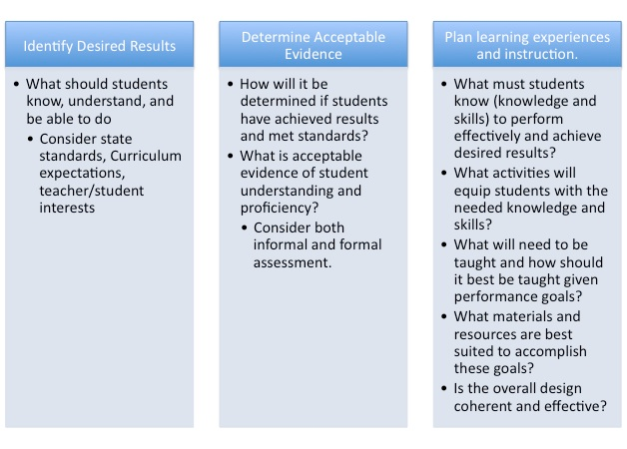

Slide 58
UbD Unit Template

Slide 59
UbD Curriculum Template
UNIT | 1 | 2 | 3 | 4
ESSNETIAL QUESTION | How can a person’s character traits affect their behavior?
CONTENT/TOPICS | A person’s behavior & personality Someone you admire
VOCABULARY | Common Adverbs
SKILLS | Adverbs (Pg. 3,5) Adjectives (Pg. 4,5) Word parts: Prefixes/Suffixes Continuous tense
ASSESSMENT | Oral Presentation Writing Assessment Performance Tasks

Slide 60
Understanding by Design Grant Wiggins and Jay McTighe
Stage One: Identify desired results
What overarching understandings are desired?
What are the overarching essential questions?
What will students understand as a result of this unit
or lesson?
What essential and unit/lesson questions will focus this unit/lesson?

Slide 63
Great Essential Questions:
Have no one obvious right answer.
Raise other important questions.
Address the philosophical or conceptual foundations of a discipline.
Recur naturally.
Are framed to provoke and sustain student interest.
Notes:
In small groups, share your essential questions and consider the characteristics of essential questions. Refine your questions as appropriate.

Slide 64
We Do!
Create a list of objectives that you would like your students to meet with your unit.
Use at least 3 standards from the 5 C’s within your unit.
Think about what you want the students to learn
Think about what is engaging to students
Think how you can relate your objectives to your standards.
For example:
SWBAT present a researched place of travel they would like to visit in an oral presentation. (Standard 1.1, 1.3, 2.1)
SWBAT use word parts to create meaning of new vocabulary words. (Standard 1.2)
SWBAT work in groups to create a dialogue about a place of travel (Standard 1.1, 1.2, 1.3, 2.1, 3.1)

Slide 65
Understanding by Design Grant Wiggins and Jay McTighe
Stage Two: Determine acceptable evidence
What evidence will show that students understand?
Performance tasks
Projects
Quizzes/ Tests
Oral Presentations
Group Work
Written Response/Research
Other evidence…observations, work samples, dialogues
Student self-assessment

Slide 66
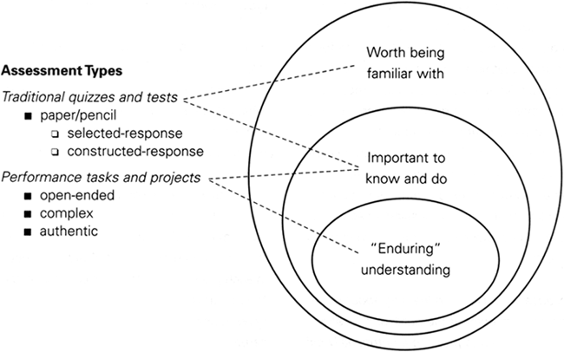

Slide 67
Stage 2

Slide 68
We Do!
Create assessments that with test whether students have met your unit’s objectives or not
Try to use 2-3 different types of assessments learned today
Include ALL assessments used in your unit: homework, in-class quizzes, in-class activities that check for understanding, group work, etc.

Slide 69
Understanding by Design Grant Wiggins and Jay McTighe
Stage Three: Plan learning experiences and instruction
What knowledge and skills are needed?
What teaching and learning experiences will equip students to demonstrate the targeted understandings?
Now the activities can be developed!

Slide 70
Learning experiences and activities should evolve after identifying desired results and determining acceptable evidence.

Slide 71
IDENTIFY DESIRED RESULTS
What do my students need to know and be able to do?
PLAN LEARNING EXPERIENCES & INSTRUCTION
How are my students going to learn what they need to know and be able to do?
DETERMINE ACCEPTABLE EVIDENCE
How are my students going to be able to demonstrate that they know it and can do it?

Slide 72
3. Create a scope and sequence
What is “scope & sequence?”
SCOPE: "The work that needs to be accomplished to deliver a product or result with the specified features and functions”
An outline of key skills and information that students need to achieve the main curriculum objective.
SEQUENCE: The order that these skills will be learned to best achieve the end goal.
Example: For a bachelor's degree curriculum, the scope and sequence might be a list of courses that a student must complete.

Slide 73
UbD Curriculum Template
UNIT | 1 | 2 | 3 | 4
ESSNETIAL QUESTION | How can a person’s character traits affect their behavior?
CONTENT/TOPICS | A person’s behavior & personality Someone you admire
VOCABULARY | Common Adverbs
SKILLS | Adverbs (Pg. 3,5) Adjectives (Pg. 4,5) Word parts: Prefixes/Suffixes Continuous tense
ASSESSMENT | Oral Presentation Writing Assessment Performance Tasks

Slide 74
STANDARDS
ENVIRONMENT
CURRICULUM
UNIT
Lesson 1
Lesson 3
Lesson 2

Slide 76
Helpful links
http://ubdexchange.org)
http://www.ascd.org/ASCD/pdf/books/mctighe2004_intro.pdf
www.ellseelearning.weebly.com

