Slide 1
Using Technology in The EFL Classroom
Best Resources for Teachers & Students to Enhance learning English!

Slide 2
Introduction
Laura Connor
English Language Fellow at MUST
ESL (English as a Second Language) Teacher and Coach in New York City.
M.A. in TESOL from Adelphi University in New York
Please ask questions throughout the presentation
Please turn cell phones on silent ☺

Slide 3
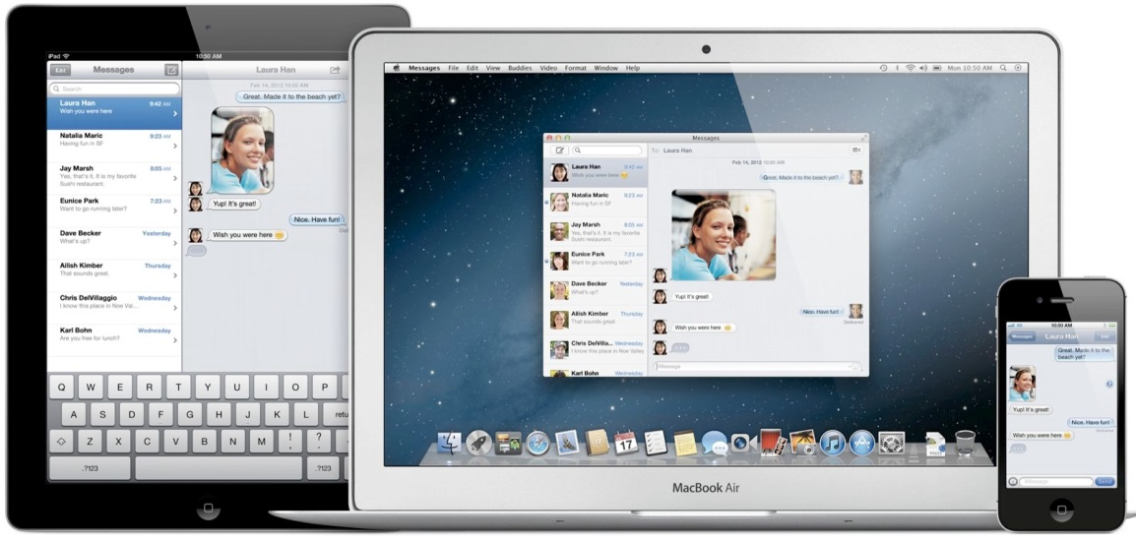
Today’s Workshop:
Overview of research on how technology can improve English learning
Teacher Resource Websites
Small Group Collaborative Learning and Planning
Group Work: Putting What We Learned Into Practice

Slide 4
KWL Warm Up
Know /want to know/ learned
What Do You Know About Using Technology in the Classroom? How do you use technology in the classroom now? | What Do You Want to Know About Using Technology in the Classroom? | What Have You Learned About Using Technology in the Classroom?
2. 3. 4. | 2. 3. 4. | 1. 2. 3. 4.
Example:
I can use technology in the classroom by having my students read an online article
Example:
What is a podcast ?

Slide 5
Just as our students are crafting their knowledge in a new way because of technology- so can we. Once you begin to spend time on these websites, you will find that your lesson plans will become more creative and innovative by nature.
ACTIVATING PRIOR KNOWLEDGE & ENGAGING STUDENTS…
http://www.youtube.com/watch?v=X5ySocUyI7I
Technology in the Classroom

Slide 6
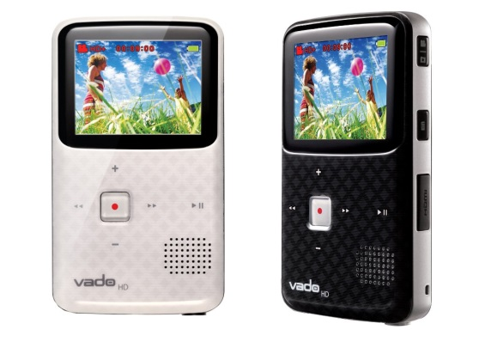
4 C’s of 21st Century Teaching:
Collaboration: Students Working Together
Communication: Students and Teachers using their language skills (reading, writing, speaking, listening) in the classroom to prepare for communication outside of the classroom
Critical Thinking: Encouraging Students to Think at a deeper level about something
Ask Why? Ask How?
Creative Innovation: Using new ideas and technology to encourage learning in a more “hands-on” way.
Why is this more important than ever with our students?

Slide 7
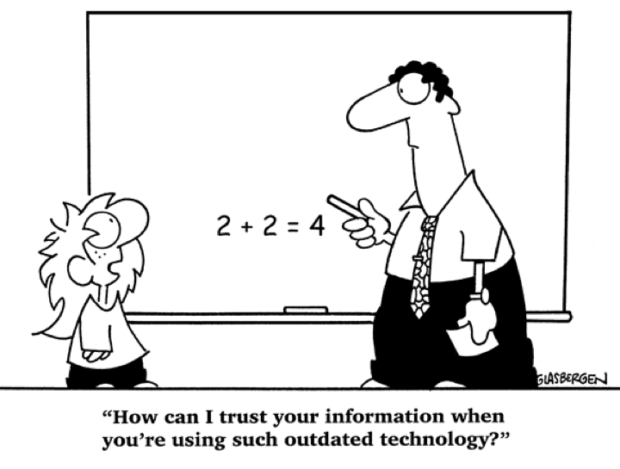
Benefits of Technology Learning:
Preparation for competing in today’s workplace
Students become active in their roles as learners
.
Collaboration
Communication
Self-Esteem
Critical Thinking
Creativity
Engagement
Notes:
They are actively thinking about information, making choices, and executing skills than is typical in teacher-led lessons.
Learners who may lack confidence in language skills tend to have an increased sense of confidence when asked to perform tasks with technology

Slide 8
Benefits of Technology For YOU!
YOUR English skills
Teaching Methods
Professional Development & Networking
New Ideas to Improve
Current Texts & Workbooks
TIME SAVER!

Slide 9
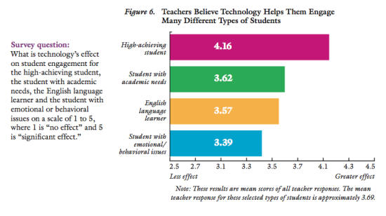
Increase Student Engagement of Different levels of learners
Source: Grunwald and Associates. (2010). Educators, technology and 21st century skills: Dispelling five myths.
Retrieved from Walden University, Richard W. Riley College of Education)

Slide 10
KWL Warm Up
Know /want to know/ learned
What Do You Know About Using Technology in the Classroom? How do you use technology in the classroom now? | What Do You Want to Know About Using Technology in the Classroom? | What Have You Learned About Using Technology in the Classroom?
2. 3. 4. | 2. 3. 4. | 1. 2. 3. 4.
Example:
I can use technology in the classroom by having my students read an online article
Example:
What is a podcast ?

Slide 11
“It is impossible to stay on top of all the current technology… So don’t worry about it! Find what works best for you and use it in a way that allows you to tap into your inner explorer.”

Slide 12
My Favorite EFL Resources
The following websites are my “go-to” when creating new lesson plans or when I am looking for new ideas to enhance my own instruction.
Think about how these sites can be used in your current classes.
Think about how these sites can be used outside the classroom as well.

Slide 13
How Do We Use Technology in the Classroom:
Work sheets, quizzes, flashcards
Warm Up: Building Background Knowledge, Sparking Discussion, Giving New Information
Small Group Activities
Grammar Practice
Writing guides: editing & grammar help
Vocabulary Study
Games, videos, music, podcasts
Homework
Project Based Learning: Student created websites, blogs, podcasts, and More!

Slide 14
My Favorite EFL Resources
My Website: www.ellseelearning.weebly.com
The following websites are my “go-to” when creating new lesson plans or when I am looking for new ideas to enhance my own instruction.
Think about how these sites can be used in your current classes.
Think about how these sites can be used outside the classroom as well.

Slide 15
Features of American English Website:
Search and browse functions
My Resource List
Save/send links
Featured materials
Promotions and events
Content Spotlight
Cultural highlights
Lesson plans
Social media connections
TESOL events calendar
New content added often!

Slide 16
http://WWW.Americanenglish.state.gov

Slide 17
Film-English.com
Film-English uses short videos & films to teach English
Teaches students to think critically, learn life lessons, and think creatively
Lesson plans, student activities with each short video lesson.
Can be used as a warm up in your lesson or as a listening activity with a small group activity after
Vocabulary, Grammar, Listening, Speaking, Reading & Writing.
Cost: FREE
Good for Beginner-Proficient in All grade levels

Slide 18
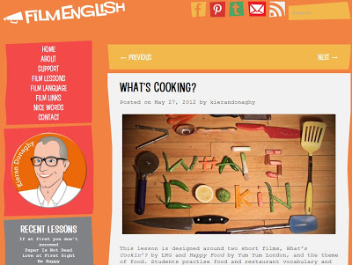
http://www.film-english.com

Slide 19
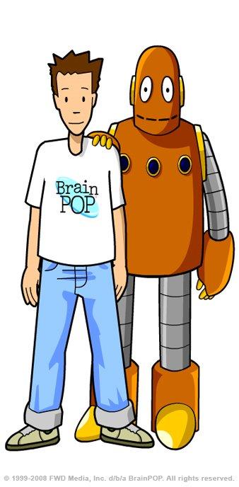
Best Video Websites
http://www.brainpop.com/free_stuff/
BrainPop
BrainPop.com has educational videos that focus on different content areas
Lesson plans, student activities with each short video lesson.
Can be used as a warm up in your lesson or as a listening activity with a small group activity after
ESP, vocabulary, listening, speaking, reading & writing.
Cost: Limited use is free. Can buy a subscription
for full access to videos and lessons.
Good for Beginner-Intermediate in Primary & Secondary grade levels.

Slide 20
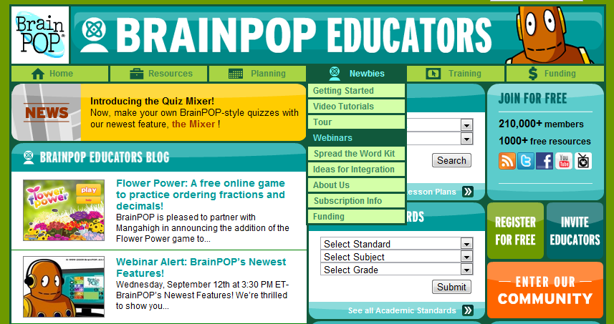
http://www.brainpop.com/educators/community/

Slide 21
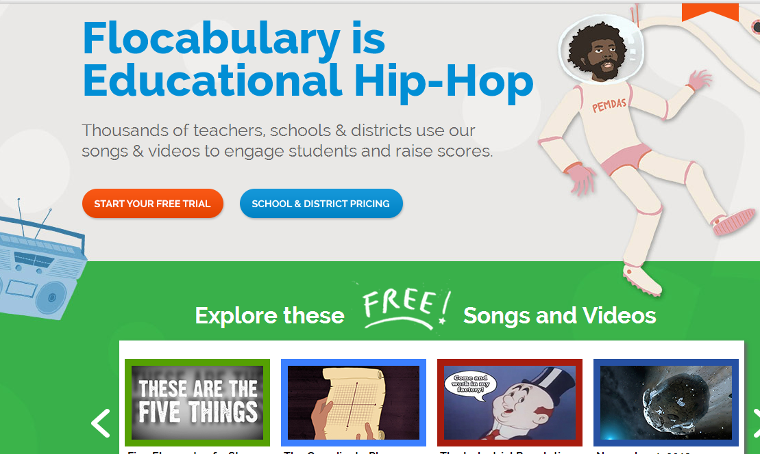
Flocabulary.com

Slide 22
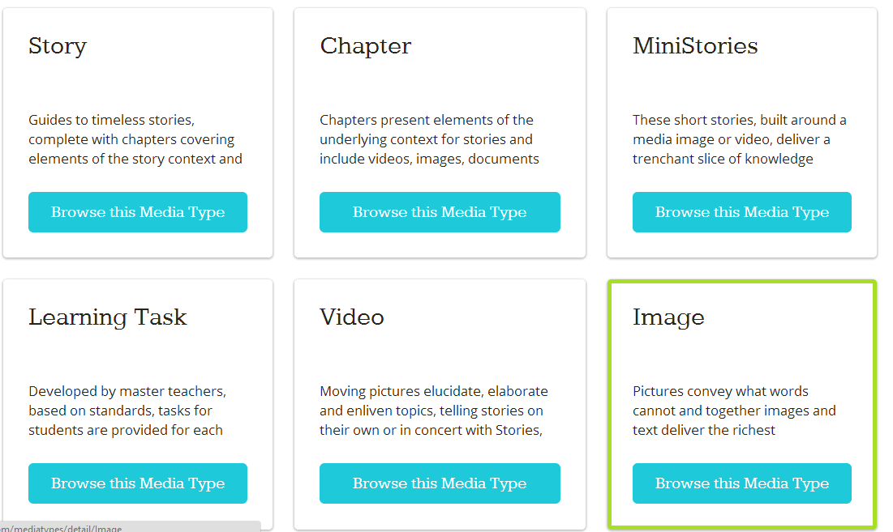
Awesome stories

Slide 23
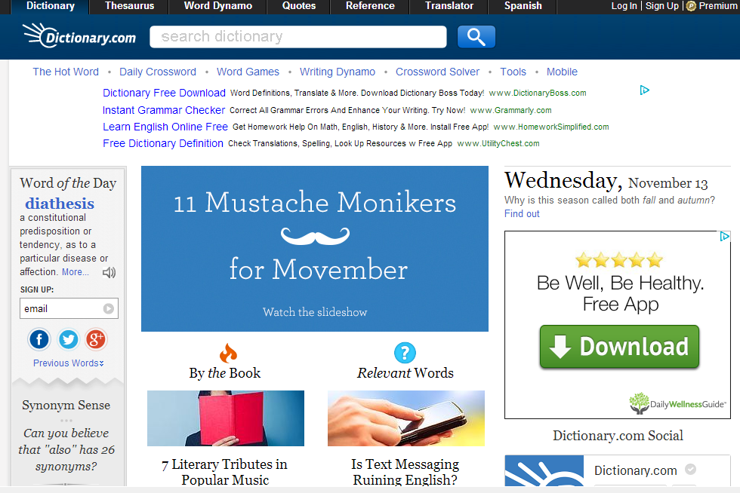
http://www.dictionary.com

Slide 24
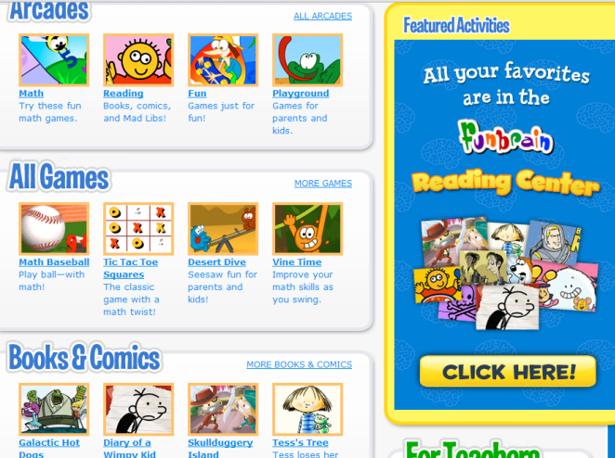
Teaching materials
websites
Well that was easy!
Here You Can Find:
Worksheets, lesson plans, classroom activities, new ideas, online quizzes, games, videos, audio, and more!
Funbrain.com
neok12.com
Manythings.org
ReadWriteThink.org

Slide 25
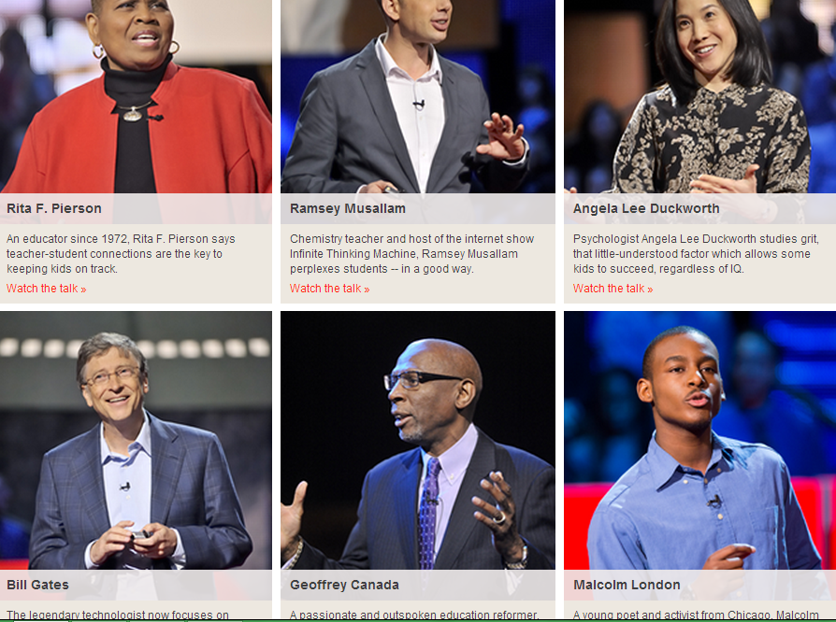
TED Talks
Inspiration!

Slide 26
TeachThought.com
If you found today’s workshop helpful, you will love this website!
It has great articles to inspire creativity and innovation in your lesson plans!

Slide 27
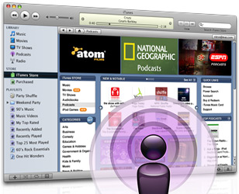
Podcasts
Great for Listening Practice &
Learning Vocabulary for Specific Purposes
A podcast is an audio file that you download from the Internet. After you download it, you can listen to it on your computer, SmartPhone, or an MP3/portable music player (for example, an iPod).

Slide 28
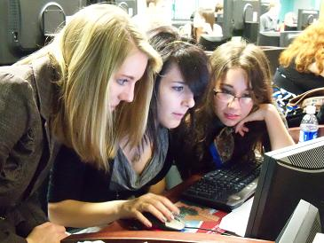
Benefits of Small Groups
Collaboration
Allows for more communication and interaction in a more relaxed setting
Students are more questions and explanations (critical thinking).
Real use of social language and English for specific purposes.
Can group students by levels and needs.
Can use less limited technology.
For example: One smartphone per group

Slide 29
“Technology is not one thing but many things that can be woven into the instructional environment to by a teacher to assist the teaching and learning process”
Kimberly A. Lawless and James W. Pellegrino, Review of Educational Research, Vol. 77, No. 4 (Dec., 2007), pp. 575-614

Slide 30
Break! And Questions

Slide 31
You Do: Choose one of the online tools explored today to create your own Lesson
Work with a partner to use ONE resource from today.
What Learning Objective will you target?
How will you use on the online resource to reach that target?
For example:
Objective: SWBAT use binomials to speak about a family member.
Website: Film-English: Film- ‘Father & Son’

Slide 32
SHARE OUT!
How did you incorporate technology into your lesson?
What questions to you still have?
Was today’s workshop helpful?
Laura Connor Contact Information:
Email: lconnor416@gmail.com
Web: www.ellseelearning.weebly.com

Slide 33
How Can You Use Technology in Your Classroom?
What are the benefits of Technology VS. Paper?
You Can Use Technology to… | You Can Use Paper to…
1. 2. 3. 4. 5. 6. | 1. 2. 3. 4. 5. 6.

Slide 34
Brought to you by Film-English.com…
http://www.youtube.com/watch?v=lmBECJJGu6I#action=share
What Product Do You Think The Ad is For?

