Slide 1
Using Technology in The EFL Classroom
Web: www.ellseelearning.weebly.com
Best Resources for Teachers & Students to Enhance learning English!

Slide 2
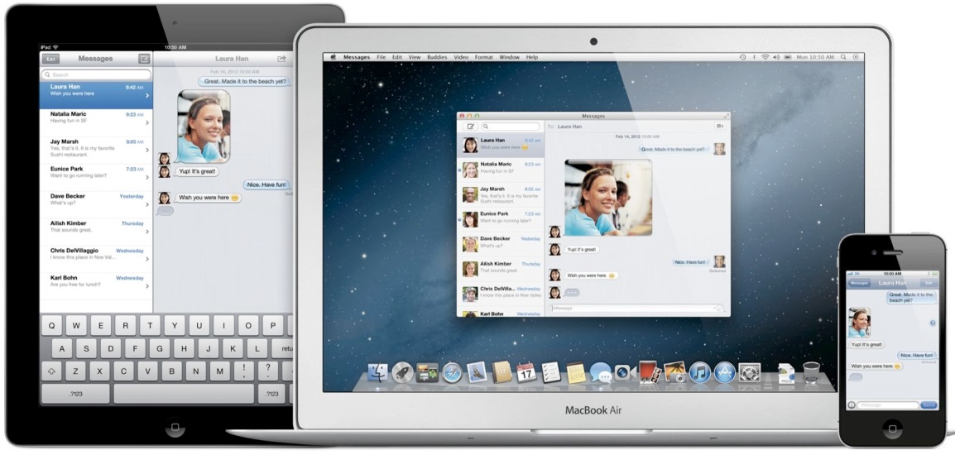
Today’s “Online” Agenda:
How technology can improve English learning
How to use technology in your lessons
Top 10 Teacher Resource Websites
Trace Effects

Slide 3
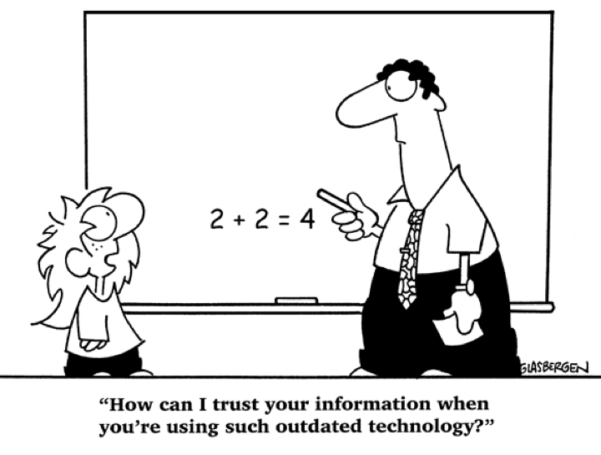
Benefits of Technology Learning:
Preparation for competing in today’s workplace
Students become active in their roles as learners
.
Collaboration
Communication
Self-Esteem
Critical Thinking
Creativity
Engagement
Notes:
They are actively thinking about information, making choices, and executing skills than is typical in teacher-led lessons.
Learners who may lack confidence in language skills tend to have an increased sense of confidence when asked to perform tasks with technology

Slide 4
Benefits of Technology For YOU!
YOUR English skills
Teaching Methods
Professional Development & Networking
New Ideas to Improve
Current Texts & Workbooks
TIME SAVER!

Slide 5
How Do We Use Technology in the Classroom:
Worksheets, quizzes, flashcards
Warm Up: Building Background Knowledge, Sparking Discussion, Giving New Information
Small Group Activities
Grammar Practice
Writing guides: editing & grammar help
Vocabulary Study
Games, videos, music, podcasts
Homework
Project Based Learning: Student created websites, blogs, podcasts, and More!

Slide 6
My Favorite EFL Resources
My Website: www.ellseelearning.weebly.com
The following websites are my “go-to” when creating new lesson plans or when I am looking for new ideas to enhance my own instruction.
Think about how these sites can be used in your current classes.
Think about how these sites can be used outside the classroom as well.

Slide 7
Features of American English Website:
Search and browse functions
My Resource List
Save/send links
Featured materials
Promotions and events
Content Spotlight
Cultural highlights
Lesson plans
Social media connections
TESOL events calendar
New content added often!

Slide 8
http://WWW.Americanenglish.state.gov

Slide 9
Film-English.com
Film-English uses short videos & films to teach English
Teaches students to think critically, learn life lessons, and think creatively
Lesson plans, student activities with each short video lesson.
Can be used as a warm up in your lesson or as a listening activity with a small group activity after
Vocabulary, Grammar, Listening, Speaking, Reading & Writing.
Cost: FREE
Good for Beginner-Proficient in All grade levels

Slide 10
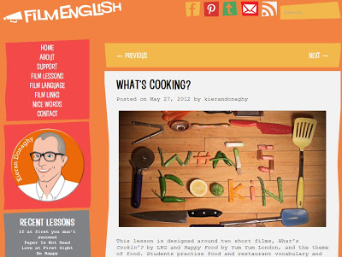
http://www.film-english.com

Slide 11
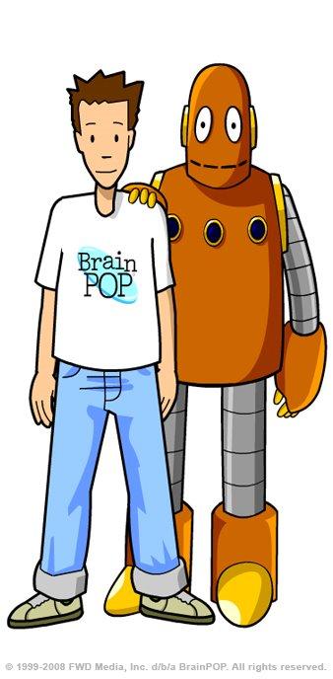
Best Video Websites
http://www.brainpop.com/free_stuff/
BrainPop
BrainPop.com has educational videos that focus on different content areas
Lesson plans, student activities with each short video lesson.
Can be used as a warm up in your lesson or as a listening activity with a small group activity after
ESP, vocabulary, listening, speaking, reading & writing.
Cost: Limited use is free. Can buy a subscription
for full access to videos and lessons.
Good for Beginner-Intermediate in Primary & Secondary grade levels.

Slide 12
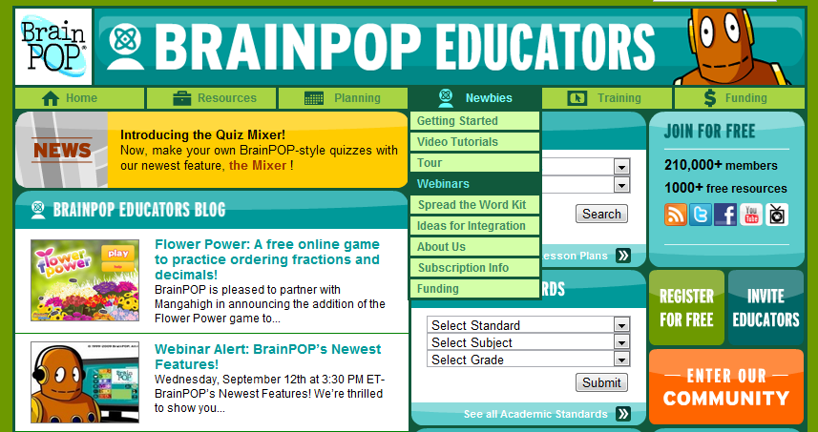
http://www.brainpop.com/educators/community/

Slide 13
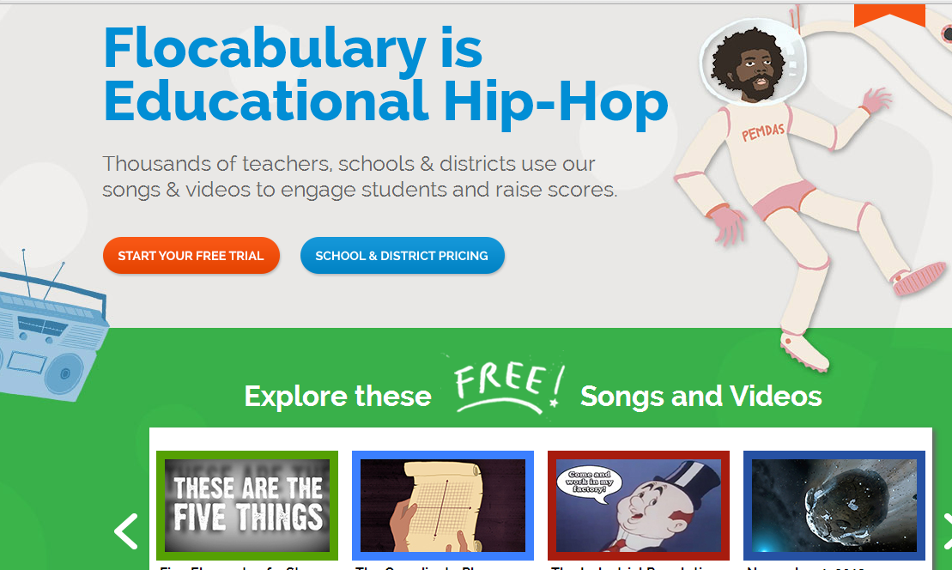
Flocabulary.com

Slide 14
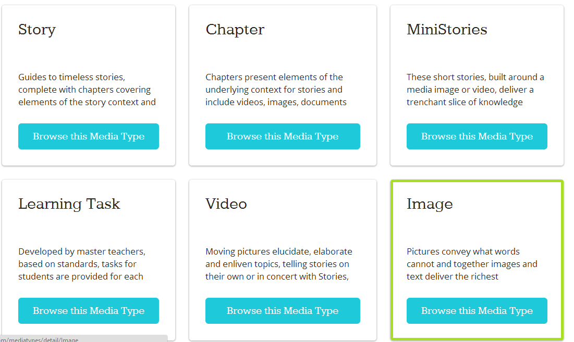
Awesome stories

Slide 15
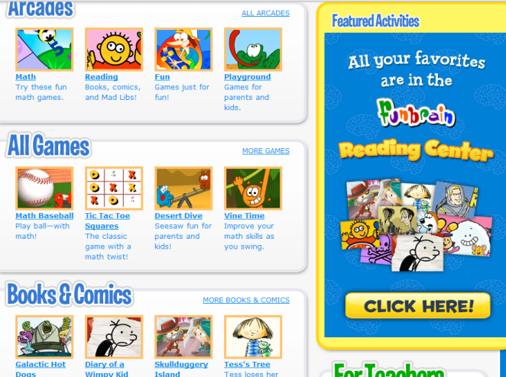
Teaching materials
websites
Well that was easy!
Here You Can Find:
Worksheets, lesson plans, classroom activities, new ideas, online quizzes, games, videos, audio, and more!
Funbrain.com
neok12.com
Manythings.org
ReadWriteThink.org

Slide 16
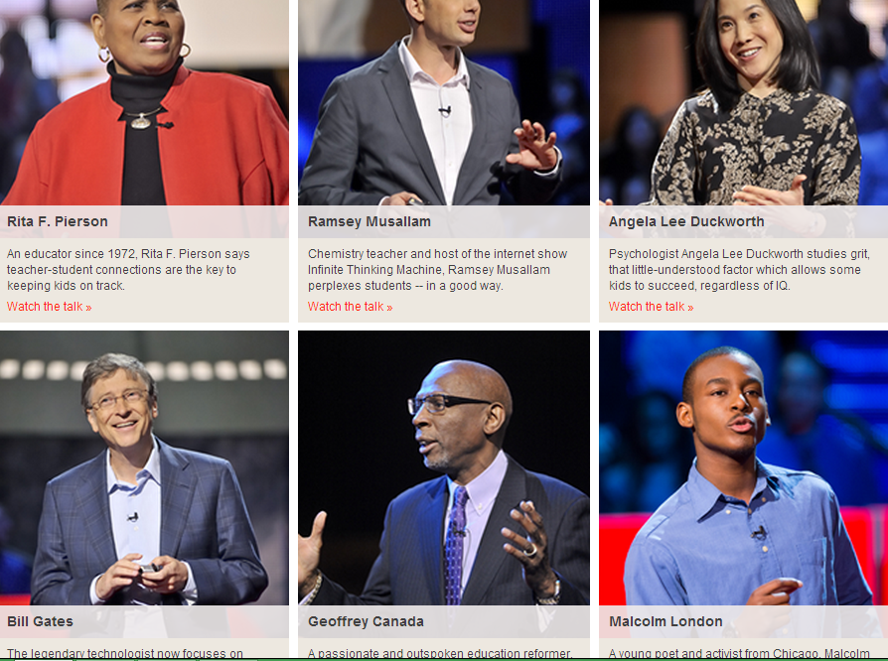
TED Talks
Inspiration!

Slide 17
TeachThought.com
If you found today’s workshop helpful, you will love this website!
It has great articles to inspire creativity and innovation in your lesson plans!

Slide 18
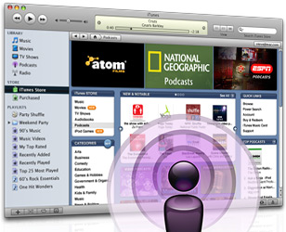
Podcasts
Great for Listening Practice &
Learning Vocabulary for Specific Purposes
A podcast is an audio file that you download from the Internet. After you download it, you can listen to it on your computer, SmartPhone, or an MP3/portable music player (for example, an iPod).

Slide 19
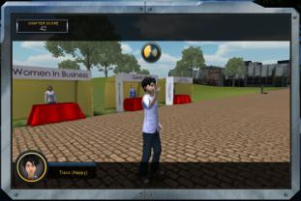
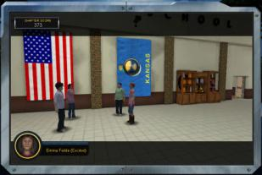
TRACE EFFECTS
Developed for EFL by the US State Department
Online & DVD video game
American culture and language through interactive 3-D immersive gaming
Features Include:
7 chapters + illustrated comics
Online and mobile language games
Teacher’s manual
Certificate of completion for each chapter
Links to key State Department, federal agency and U.S. educational sites
Notes:
(Rick)
A premier example of the quality offerings of the web portal is Trace Effects - a FREE video game / virtual world for English language learners
Several key developments have taken place in its design.
Storyline and characters have been developed, and the program has been both redesigned, including new functions.
Industry experts were brought in as consultants to help ensure Trace develops into a pedagogically sound English language learning tool.
At present, the plan is to pilot the program periodically using RELOs, ELFs and students in the English Access Program.
It will be phased-in through 2012 for final launch by the mid-year
Access English Online will complement a student’s classroom English language instruction through Web-based, interactive, 3D multimedia learning activities. This enhanced means of gaining English language skills will also provide exposure to American culture and society. The themes covered include community activism, environmental conservation, entrepreneurship, female empowerment, science and innovation, leadership and mutual understanding.

Slide 20
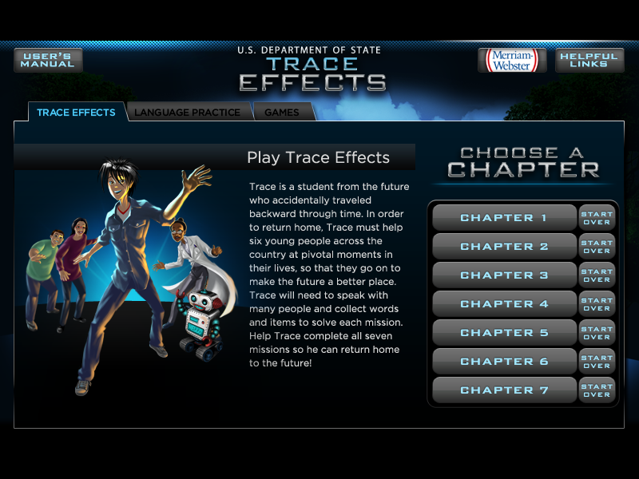
Notes:
Game shell components

Slide 23
questions
LCONNOR416@GMAIL.COM
WWW.ELLSEELEARNING.WEEBLY.COM

