Slide 1
RESEARCH WRITING
Laura Connor
English Language Fellow, Mongolia 2013
Presentation Series ACMS December 2013
www.mustresearch.weebly.com

Slide 2
Today’s Agenda
By the end of this workshop, you will be able to…
Understand and identify the organizational structure of a research paper.
Answer questions about your own research.
Identify and use correct writing and grammar formatting for a research paper
Many of today’s ideas were found in :
Hanyang’s English Solutions Text Online
http://www.hanyangowl.org/media/textbook/engsciresearchwritingbook.pdf
AIT’s Research Writing Text Online
http://www.ait.ac.th/education/LanguageCenter/ait-writing-services/guide-book/index.htm#.Uql0AOJ-Yvl

Slide 3
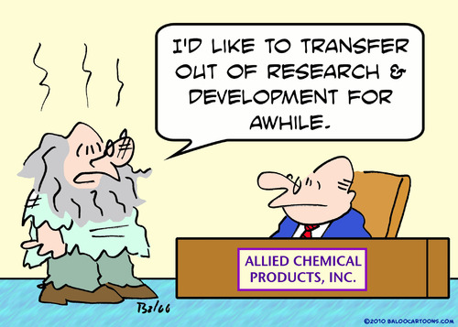
What is the purpose of Research Writing?
Purpose:
Present in a Conference
Publish in journals or articles
Grants
*Make an impact on YOUR field of research because it is something that YOU are passionate about!!

Slide 4
How is a Research Paper Organized?
abstract
Introduction Lit. Review
method
results
discussion
conclusion
Adapted from Writing Up Research by Robert Weissberg & Suzanne Buker (2008)
References & Appendices

Slide 5

Introduction→ What’s the purpose?
Comes at beginning of the paper
You are giving the reader background knowledge to ease them into understanding your research and the problem that will be solved by your work.
Explains WHY the research is being
done (rationale)
*This is important for the reader to
understand the significance of the study.
Notes:
YOU ARE SELLING YOUR PAPER WHEN GIVING YOUR RATIONALE– YOU ARE CONVINCING THE READER THAT YOUR WORK IS SUPER IMPORTANT

Slide 6
Introduction: Parts
YOUR INTRODUCTION SHOULD INCLUDE:
  BACKGROUND
  RATIONALE
    WHY DO WE NEED TO RESEARCH THIS? WHY DOES IT NEED TO BE IMPROVED? WHAT GAPS ARE THERE CURRENTLY?
  PROBLEM STATEMENT (SIMILAR TO THESIS STATEMENT)
  OBJECTIVE- HOW YOU WILL SOLVE THE PROBLEM
  SCOPE- WHAT IS THE PRIMARY FOCUS? WHERE IS THE STUDY FOCUSED ON?
  LIMITATIONS- WHAT MAY PREVENT ALL QUESTIONS FROM BEING ANSWERED
  ASSUMPTIONS- WHAT DO YOU KNOW TO BE TRUE ALREADY?

Slide 7
WRITING FOCUS: CONJUNCTIONS/TRANSITION WORDS
Throughout research writing, conjunctions and transition words are often seen.
Sentence structure helps avoid punctuation errors and tense issues.
CONJUNCTIONS are used to connect clauses, and give more information in one sentence.
TRANSITION WORDS are used to connect sentences and make your writing flow.

Slide 8
Conjunctions
CONJUNCTION: signals HOW the two clauses link together.
  Example:
    I like ice cream, but it makes me fat.
    Conjunction = BUT → signals a positive and negative- or 2 differing ideas on the same subject
    I am studying English because I want to improve my fluency.
    Conjunction = BECAUSE → signals that you are given a REASON for the main clause…. Always answers the question WHY.
    It is cold out, so I wear a jacket.
    Conjunction = SO → signals the result of the main clause. (cause & effect)

Slide 9
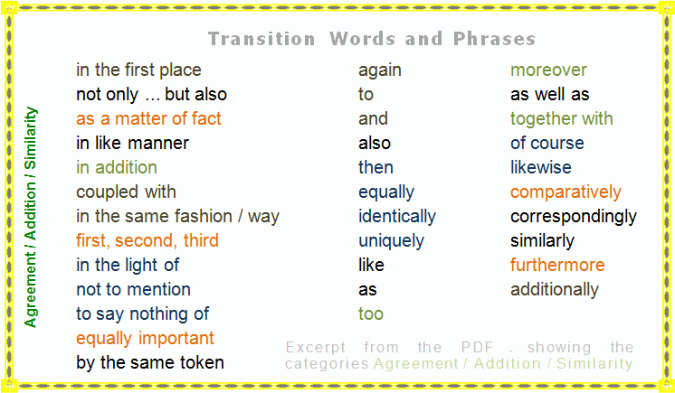
Transition words are important too…

Slide 10
CONJUNCTION REVIEW
COMPLETE THE FOLLOWING SENTENCES…
English has become the international language because throughout the world, this language is spoken.
English has become the international language but I only speak English a little bit.
… but it is not my chosen foreign language
… but it is too dominant.
… but we should study our Mongolian perfectly first.
English has become the international language so we want to speak the language very well.
…. So I want to speak in English fluently.

Slide 11

Literature Review

Slide 12

“ The greatest part of a writer’s time is spent in reading, in order to write:
a man will turn over half a library to make one book.”
~ Samuel Johnson

Slide 13
Literature Review
Why is it important?
PROVIDES RATIONALE (SOUND REASON) FOR YOUR RESEARCH WORK
TO BETTER UNDERSTAND YOUR TOPIC:
  THE MORE YOU READ THE MORE YOU KNOW!
TO HELP DEVELOP YOUR RESEARCH WRITING
  IDENTIFY GAPS, OR AREAS THAT COULD USE MORE RESEARCH
  HELP TO FOCUS YOU RESEARCH TOPIC
  HELP DEVELOP YOUR ARGUMENT
  LEARN FROM THE WAY OTHERS IN YOU FIELD WRITE
READING CURRENT RESEARCH WILL LEAD YOU TO OTHER AUTHORS, AND THEREFORE NEW IDEAS
Notes:
Ask students why its important– review from ariel’s session

Slide 14
How to Choose a Research Article
  1. Create a list of topics that will help you defend your opinion or create the necessary background knowledge for your research paper.
  2. Search for those topics in search engines:
  ERIC / JSTOR / Google Scholar
  You may also find a site that has article specific to your field (ex: Cambridge & TESOL have many English journal articles)
  3. Decide if that piece of literature is worth reading/will help to truly support your thesis.
  - Look at abstract/introduction/resource list
  4. Add to your Literature Review Chart

Slide 15
AUTHOR | SOURCE TITLE | GENRE | Where & When Published | Summary & Additional Details
McKay, Sandra Lee | Example: Teaching English as an International Language: An introduction to the role of English as an international language and its implications for language teaching. | Book | London, Britain: March 2002 | Describes the spread of English worldwide and its practical and educational consequences Discusses the problem of how we define standards when the notion of a single 'standard' form of English is no longer valid Explores the critical role of culture in language teaching Looks at the implications of English as an international language for current teaching methods Suitable for trainee and practising teachers and other ELT professionals, especially curriculum and materials developers.
Curry, Mary Jane | Critical Thinking: Origins, Applications, and Limitations for Postsecondary Students of English as a Second Language | Article | Montreal, Canada: April 1999 | This paper explores the similarities, overlaps, and differences in the multiple meanings of critical thinking, looking at the origins of the field, its uses in the educational enterprise, its limitations, including cultural and feminist critiques, and issues that arise in including critical thinking in curricula for postsecondary ESL students

Slide 16
English Paragraph Structure
Topic Sentence : General statement that informs the reader about the topic of the paragraph.
Detail 1 – Should refer to topic sentence.
Detail 2 – Should link #1 to new information.
Detail 3 – Should link #2 to new information.
Conclusion – Summarize and restate
And/or make reference to the next paragraph’s topic (transition).

Slide 17
Topic (General)
TECHNOLOGY
Topic Sentence (General Background Information)
2.Supporting Details that relate to your topic sentence (Most specific)
3.Concluding Sentence to bring it all together. (ThesisStatement)
Technology is used throughout the world, and is becoming a necessity in most countries.
Technology is used in social media
Families & Friends rely on technology to communicate.
Businesses rely on technology to compete in the economy.
Technology has now become a major component
of people connecting throughout the world.

Slide 18
Create supporting details
PRACTICE WRITING FROM GENERAL → SPECFIC DETAILS BELOW:
TS: Teaching is a rewarding career that allows you to impact others.
Detail 1: It brings much happiness and greatness to both myself and my students.
Detail 2: We educate and encourage young people to succeed in life and in their careers.
Detail 3: Therefore, it influences not only this generation, but for many to come in the future.

Slide 19
Lit. Review Outline:
Paragraph Topic | Details
Introduction | G.S.: S.S. 1 S.S. 2 S.S. 3 Th.St.:
 | G.S.: Detail 1: Detail 2: Detail 3: C.S.

Slide 20


Slide 21
How is a Research Paper Organized?
abstract
Introduction Lit. Review
method
results
discussion
conclusion
Adapted from Writing Up Research by Robert Weissberg & Suzanne Buker (2008)
References & Appendices

Slide 22

METHODS SECTION
Purpose
Describe what was done to answer the research question, describe how it was done, justify the experimental design, and explain how the results were analyzed
How the results were achieved
Explanation of how data was collected/generated
Explanation of how data was analyzed
Explanation of methodological problems and their solutions or effects

Slide 23
METHODS SECTION
Parts
Scientific writing is direct and orderly. Therefore, the methods section structure should be in chronological (time) order:
Describe the materials used in the study & explain how the materials were prepared for the study
Describe the research protocol (what did your research require you to do?)
Explain how measurements were made and what calculations were performed
State which tests were done to analyze the data.
When editing or adding to your paper:
Use sub-sections according to topic
Organize material/data by topic from most to least important.

Slide 24
Writing Your Methods Section
Keep notes of what you did, why you did it, and what happened.
Keep a research diary so that you have a record of the methods used.
Avoid using personal pronouns like “I” or “WE”
One way to avoid this problem is to use passive voice.
Verb tenses - be consistent, and choose the correct one!
Notes:
, and that you then carefully select which material to include in your final methodology section. Make sure you develop some way of recording your work.

Slide 25
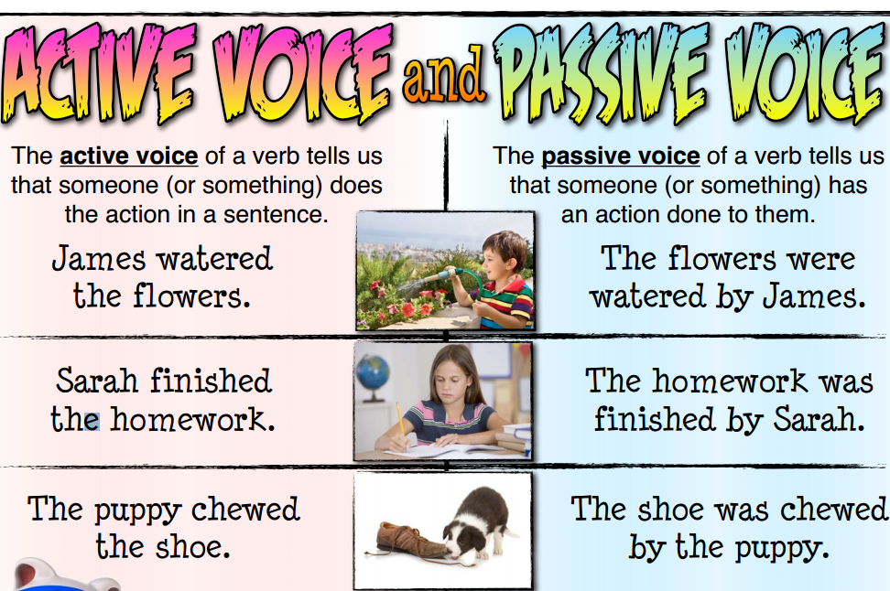

Slide 26
Passive voice verbs
You can recognize passive voice because the verb phrase will include a form of be (was, am, are, been, is).
  Example: The research was conducted over a period of 10 weeks.
Sometimes a prepositional phrase like "by the" in the sentences above indicates that the action is performed on the subject, and that the sentence is passive.
  Example: The experiment was conducted by the researcher.

Slide 27
YOU TRY
Examples:
Active or Passive:
The researchers administered the survey to a variety of populations.
The survey was administered to a variety of populations by the researchers.
Active or Passive:
All books in this study were donated for use by the researcher’s school
Write 1 sentence about your research in the passive voice.
Remember to put the object first, followed by perfect past tense of the verb.

Slide 28
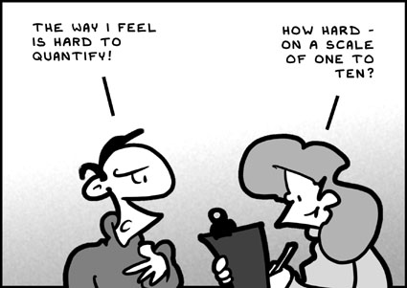
Research Methods for Social Sciences
Qualitative Research can sometimes be difficult.
Some ways to collect data for qualitative research are:
Interviews
Focus Groups
Surveys
Case Study
Running Record
Questionnaires
For more information, visit:
http://www.emeraldinsight.com/research/guides/methods/

Slide 29
Using sequence words
Sequence words are important to use during this section of your writing so that others may easily follow the steps of your methods of research.
Examples:
first, then, also, after, next, finally, while, as soon as, consecutively, simultaneously, and sequentially.

Slide 30
What methods are in your research?
Your turn!
Write the sequence of methods that you took to collect data, or WILL use to collect data.
Be aware of verb tense
First,
Subsequently,
While,
Consequently,

Slide 31
Results & discussion
Purpose: To report what you have concluded based on your research, and to give your point of view about what these results mean
Can be organized in different ways depending on the type of paper, and depending on what YOU want to emphasize
ALWAYS begins with a review of the purpose or methodology
Must have words, not just tables

Slide 32
2 WAYS OF ORGANIZATION:
Two separate sections: Presenting all the results in a single section; then providing a discussion of the results in a separate section
One section: Presenting some of the results or findings and then discussing them, until all key results are presented
*You should look for a method of presentation that makes the information and ideas you are presenting as clear as possible to the reader.
Notes:
(the Discussion or the Analysis section.)

Slide 33
Results vs. Discussion
Results
  Only give data
  No claims or opinions
  Wording should be neutral
  What you point out here should be discussed thoroughly later
Discussion
  Claims
  Surprising results
  Explanation
  Comparisons

Slide 34

Parts of the Results Sections
Review of purpose or methodology
Additional background
Result (with or without reference to specific figure or table data)
Claim: what is your opinion based on the data you collected?
Unexpected Outcome: did anything surprise you in your research?
Explanation for result
Comparison: are your results similar to any of the research in your lit. review?

Slide 35
Results – What verb tenses do I use?
Review of purpose – past tense (what we DID)
Additional background – present (facts)
Location and description of your table – present (Fig 1 shows) or (the x axis is…)
Results – past tense (what you discovered)
.

Slide 36
Discussion Section:
What verb tenses do I use?
Claim – present tense (your opinion)
Unexpected results – past tense if it is something that happened during the experiment, present if it is data.
Comparison – present tense
Now, try to write one sentence for each part of the discussion.

Slide 37



What makes a conclusion different?
Results = Just the facts
Discussion = Claims and opinions based on the facts
Conclusions = Application of research to a larger setting
http://netdna.seospecialist.co.uk/wp-content/uploads/2011/04/conclusions-seo-analysis.jpg

Slide 38
5 Parts of the Conclusion
Review: purpose and review the important findings
Speculations: to analyze what your finding mean/ effects of your findings
Limitations: what did you not include in your research & why?
Implications: To “sell” the importance of your research
To apply your research to a broader setting
  (ex. Government, education, business, etc.)
5. Recommendations: to give suggestions for future research

Slide 39

1. Review
Restate the purpose of the study
Summarize your most important findings
(state strongly)
The present study offers clear
evidence that “hands-on experience”
is not sufficient for the productive
learning of computer programming
by novices.
http://www.magicalmaths.org/wp-content/uploads/2012/11/conclusion-introduction-starter-pleanary-150x150.gif

Slide 40

2. Speculations
Why did this happen? (good or bad results)
Why are these results important?
Explanations about the findings as a whole
One possible conclusion is that the requirements of the speed jobs in the light industry under study do not make physical demands on the older workers
to the limits of their reserve capacity. The
competence and experience of the older
workers in these specific jobs may have
compensated for their reduced stamina.
http://www.grand-illusions.com/acatalog/non_transitive_dice_2.jpg

Slide 41

3. Limitations
Where CAN’T we apply these findings?
When will this NOT work?
How far will these conclusions take us?
Finally, since there was a surprising lack of
consensus among the students in our sample,
it would not be advisable to draw concrete
conclusions from these results.
http://careerchangebreakthrough.com/wp-content/uploads/2011/07/limitations.jpg

Slide 42
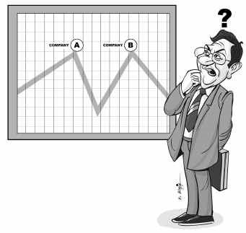
4. Implications
What can you say generally, based on these results?
How could this affect further research?
How could it affect your discipline?
Do current practices match your results?
We can no longer assume that it is satisfactory to
seek explanations only in economic factors.
OR
These findings lead us to believe that more
difficult materials should be used in order to
give ESL students additional practice in
comprehending English texts.
http://inspectyourbrand.com/wp-content/uploads/2011/11/inspectyourbrand1.jpg

Slide 43

5. Recommendations
What do you want people to DO or CHANGE based on your research?
Practical applications beyond the lab
Further research (yours or others)
From our results, we suggest that the
optimal level of indentation for a
computer program is 2-4 spaces.
This should be standardized in word
processing education classes.
http://careerpivot.com/wp-content/uploads/2012/11/Advice.jpg

Slide 44

Last but not least…
References: lists all works cited throughout your paper
Appendices: Often items referred to in your methods section. Can also include an item that was produced as a result of your research
  Example: A word list that was generated after researching English for Engineering texts.
  Example: Running record completed while observing communication between male and female coworkers.

Slide 45
Let’s Review
Part of Research Paper | Purpose
1.
2.
3.
4.
5.
6.
7.
8.

Slide 46
Writing Review
Write 3 detail sentences using this topic sentence. Make sure to use conjunctions/transition words, sequence words if needed, passive voice, and the same verb tense throughout!
TOPIC:
TS:
Detail 1: (Use conjunction)
Detail 2: (Use passive voice)
Detail 3: (Use transition word)
CS:

Slide 47

Questions*Comments
LCONNOR416@GMAIL.COM
WWW.MUSTRESEARCH.WEEBLY.COM
www.ellseelearning.weebly.com

