Slide 1
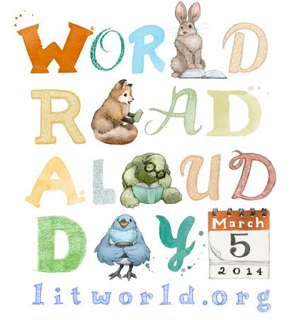
Ulaanbaatar 2014 School 23
Mongolia Read Aloud

Slide 2
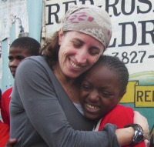
Hello to Our Friends in Mongolia! We were so excited to hear about the World Read Aloud Day celebration that you have planned in Ulaanbaatar. Today you are part of a global movement. Over 1 million people from 65 countries are celebrating World Read Aloud Day and together we are showing the world that our words and our stories matter. Together we are changing the world. Thank you for reading aloud today. –Pam Allyn & The LitWorld Community

Slide 3
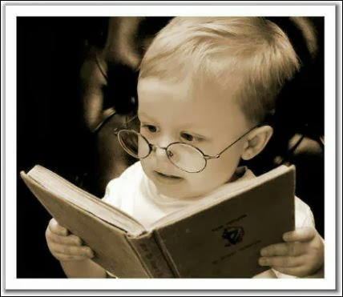
Why is reading so important?!

Slide 4
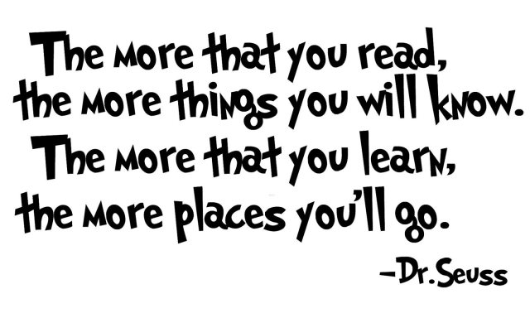
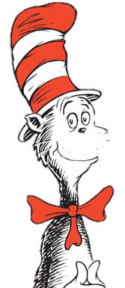
Notes:
It is a FACT, people who read more…
Are able to communicate ideas better
Are able to think creatively
Are more likely to go to college
Are more likely to get higher paying jobs
Are better writers
Will see more places and more success in life!

Slide 5
PARTICIPATION = RAFFLES → RAFFLES = PRIZES!

Slide 6
Lesson 2:
GIVING &
BEING GRATEFUL
adjective: grateful
being thankful
талархал

Slide 7
What is one thing you are grateful for today?

Slide 8
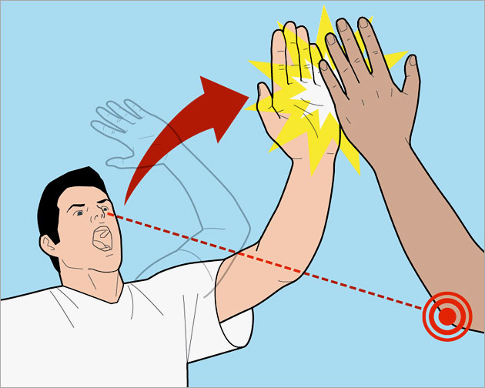
Lesson 1: How to give the perfect high five!

Slide 9
"Give A Little Bit"
Give a little bit _1.________ a little bit of your ­­­­­­­­­­­­­­­­­love to me Give a little bit I'll give a little bit of my __2.________ to you See the man with the __3.________eyes Take his __4._______, you'll be surprised So I’ll give a little bit I'll give a little bit of my __5._________ for you So give a little bit Give a little bit of your __6.__________ to me Now's the time that we need to ___7.__________ So send a _8.__________, we're on our way back _____9._____________
GIVE
LOVE
LONELY
HAND
LIFE
TIME
SHARE
SMILE
HOME

Slide 10
What is one thing that you have given to another person lately?

Slide 11
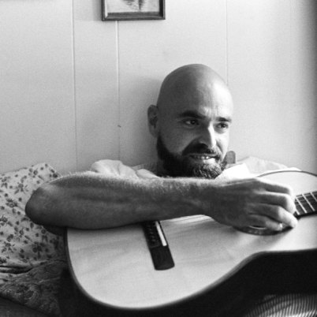
Author: Shel Silverstein
Born on September 25, 1930 in Chicago, Illinois
Began writing and drawing at a young age because he didn’t fit in
He became a cartoonist, playwright, poet, performer, recording artist, and Grammy-winning, Oscar-nominated songwriter.
Notes:
Drew because he wasn’t popular
Publishers didn’t want the book because they said they couldn’t tell if it was a book for adults or for children.
Became one of the most read books in the US

Slide 12
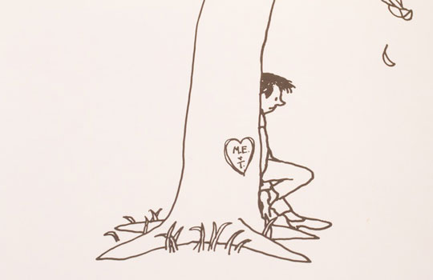
Vocabulary: Selfish vs. Selfless

Slide 13
The Giving Tree by Shel Silverstein

Slide 14
Notes:
Make predictions
PARTS OF THE TREE

Slide 15
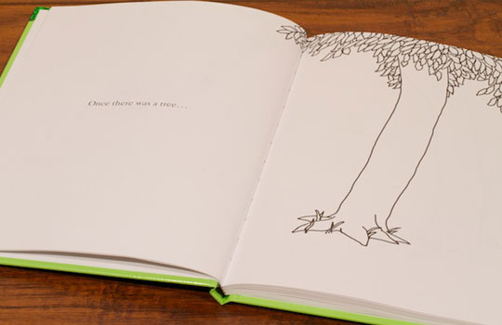
Your Job as a Reader…
Try to picture the little boy and how he is with the tree
What is the boy and the tree’s relationship like?
What does it mean to love someone?
What do we do for the people we love?

Slide 16
Stop & Think: Page 26
What are you picturing as you hear the story?
Draw a picture to describe the story so far.
Share and explain with your partner

Slide 17
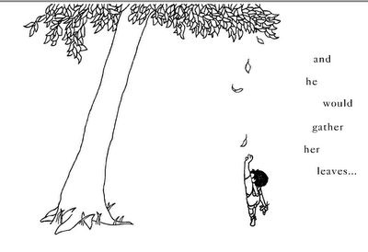

Slide 18
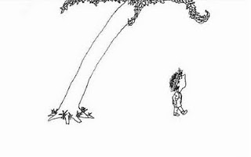

Slide 19
But time went by…

Slide 20
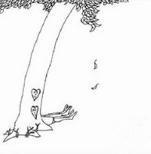
How many feet do we see here? What is different about the tree? What is different about the boy? (Page 31)

Slide 21
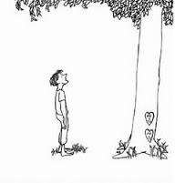

Slide 22
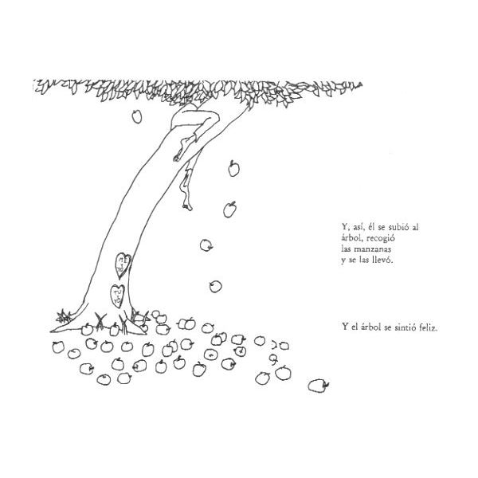
Why was the tree happy when the boy took her apples and carried them away? What do you think about the boy at this point? (Page 37)

Slide 23
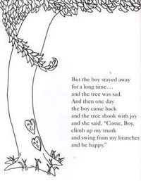

Slide 24
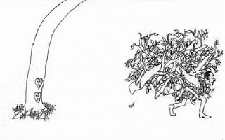
Do you think the tree should offer the boy her branches? Why or Why Not? (Page 39)

Slide 25
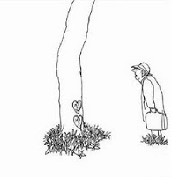

Slide 26
PREDICTION: What do you think will happen next?

Slide 27
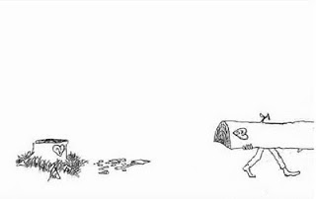
And so the boy cut down her trunk.
And made a boat and sailed away.

Slide 28
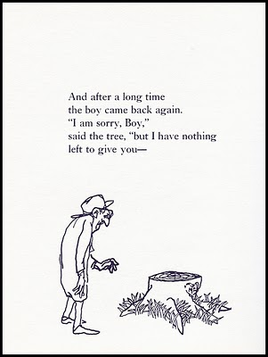

Slide 29
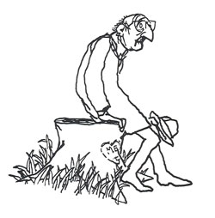
And the boy did and
The tree was happy.
The End.

Slide 30
Post Reading Questions
Why do you think Shel Silverstein wrote this book ?
What do you think it means to love someone? Can you love someone too much?
Who is happy throughout the story, the tree or the boy? Why?
How can you relate this story to the real world?

Slide 31
Post Reading Activity
You will pick one part of the story to change. You may want to change the characters or parts of the story to be more modern.
With your partner, write a dialogue between the boy and the tree (nature), except this time the boy GIVES back to nature instead of taking away. Draw picture to go along with it.
Choose from the following parts:
When the boy takes the apples to sell.
When the boy takes the branches to build a home.
The end of the story: would you write the ending differently? How would you change this story?

Slide 32
Exit Question
What is one way YOU can give back to others, your community, or nature?

Slide 33
"Give A Little Bit" Give a little bit Give a little bit of your love to me Give a little bit I'll give a little bit of my love to you See the man with the lonely eyes Take his hand, you'll be suprised So I'll give a little bit I'll give a little bit of my life for you So give a little bit Give a little bit of your time to me Now's the time that we need to share So send a smile, we're on our way back home ooh yea yea. We gotta feel it Yea yea yea yea...Ooo

Slide 34
Don't you need to feel at home Ooo you gotta feel it Yea you gotta want to OO you gotta sing, we've come along way tonight
So give a little bit Give a little bit of your love to me I'll give a little bit I'll give a little bit of my life for you Now's the time we need to share So send a smile, we're on our way back home Yea come along too - Yea we gotta feel it Cause I need to feel at home Come along too, Such a long ride oo come a long way, Such a long ride Come a long way Sing it tonight

Slide 35
THANK YOU FOR CELEBRATING WORLD READ ALOUD DAY WITH US! For Pictures from today…
www.ellseelearning.weebly.com
www.litworld.org
Visit our facebook page:
U.S. Embassy - Ulaanbaatar, Mongolia

